Slide 1
CMPE223 / ISYE223 ALGORITHMS AND PROGRAMMING 2024 – 2025 Spring
CYPRUS INTERNATIONAL UNIVERSITY
ENGINEERING FACULTY
Lecture 5
Search Algorithms

Slide 2
Search Algorithms
Search operation is one of the key operations in array processing
A Search algorithm can be implemented as :
A strategy that searches for a specified search key within an array
In case of finding the search key, the algorithm should return an indicator return value, that can be the array index number
In case of not finding the search key, again the algorithm should return an indicator return value, that can be -1. A negative index cannot be an array index, thus, selecting a negative number is useful to indicate that the search key is not found.

Slide 3
Search Algorithms
There are several search strategies:
Linear Search ***
Sentinel Linear Search
Binary Search ***
Meta Binary Search | One-Sided Binary Search
Ternary Search
Jump Search
Interpolation Search
Exponential Search
Fibonacci Search
The Ubiquitous Binary Search
Linear Search and Binary Search algorithms will be studied in lecture notes.

Slide 4
Linear Search Algorithm
Linear Search is defined as a sequential search algorithm that starts at one end and goes through each element of a list until the desired element is found, otherwise the search continues till the end of the data set. It is the easiest searching algorithm.
CMPE223 ALGORITHMS AND PROGRAMMING

Slide 5
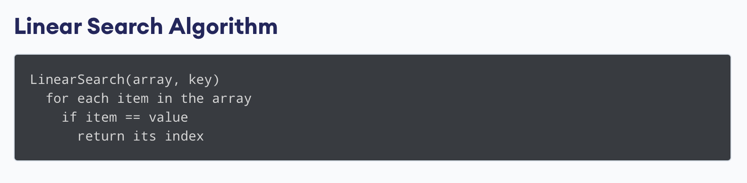
Linear Search Algorithm (cont’d)
Given an array arr[] of N elements, the task is to write a function to search a given element, let say searchkey x in arr[].
Examples:
Input: arr[] = {10, 20, 80, 30, 60, 50,110, 100, 130, 170}, x = 110;
Output: 6
Explanation: Element x is present at index 6
Input: arr[] = {10, 20, 80, 30, 60, 50,110, 100, 130, 170}, x = 175;
Output: -1
Explanation: Element x does not present in arr[].
CMPE223 ALGORITHMS AND PROGRAMMING

Slide 6
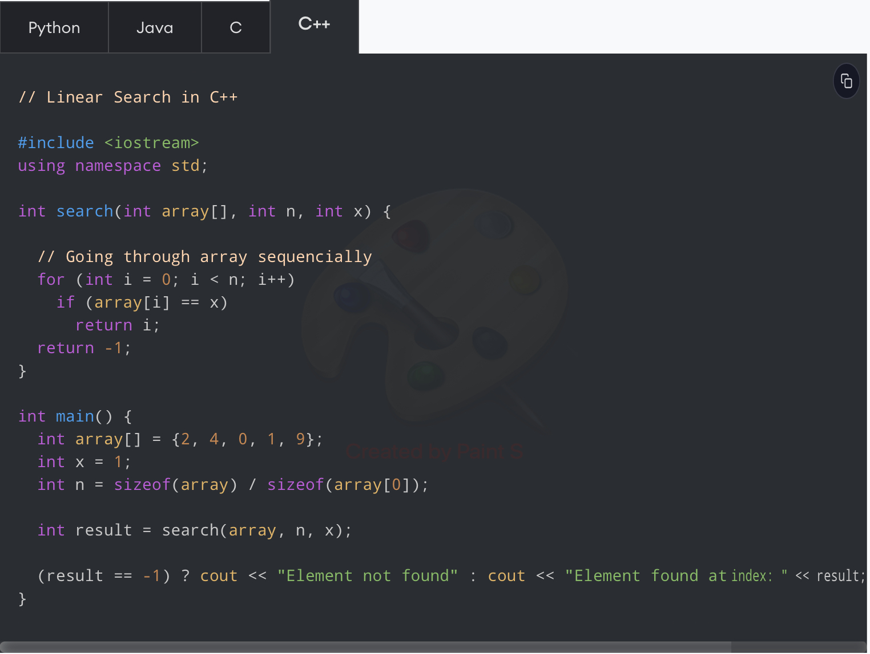
Linear Search Algorithm (cont’d)
CMPE223 ALGORITHMS AND PROGRAMMING

Slide 7
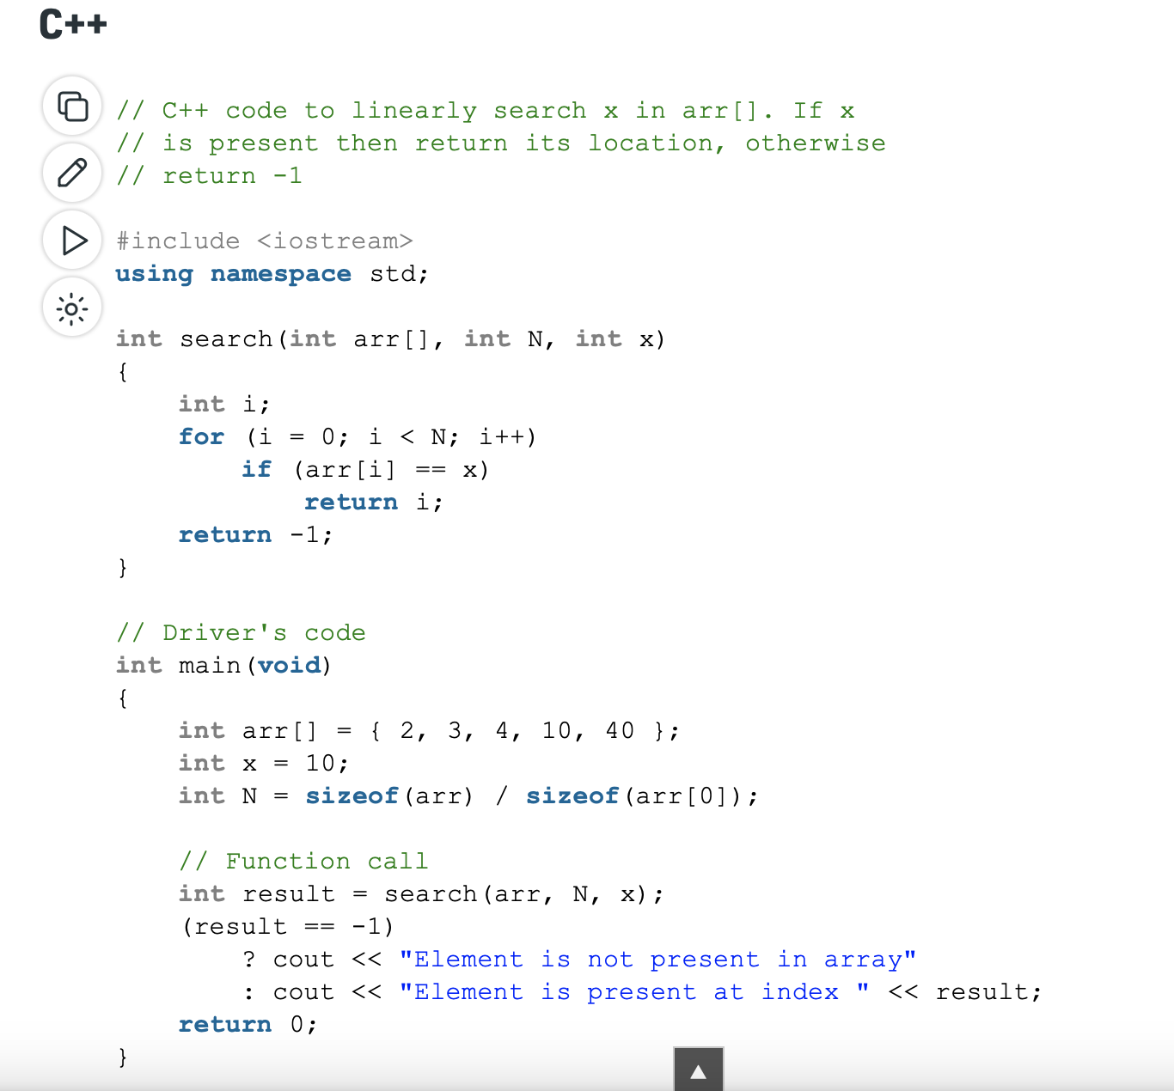
CMPE223 ALGORITHMS AND PROGRAMMING

Slide 8
Binary Search Algorithm
Binary Search Algorithm can be implemented in two ways which are discussed below.
Iterative Method
Recursive Method
The recursive method follows the divide and conquer approach, which is not covered in lecture yet.
The general steps for both methods are discussed below.
Given an array arr[] of N elements, the task is to write a function to search a given element x in arr[].
Examples:
Input: arr[] = {10, 20, 80, 30, 60, 50,110, 100, 130, 170}, x = 110;
Output: 6
Explanation: Element x is present at index 6
Input: arr[] = {10, 20, 80, 30, 60, 50,110, 100, 130, 170}, x = 175;
Output: -1
Explanation: Element x is not present in arr[].
CMPE223 ALGORITHMS AND PROGRAMMING

Slide 9
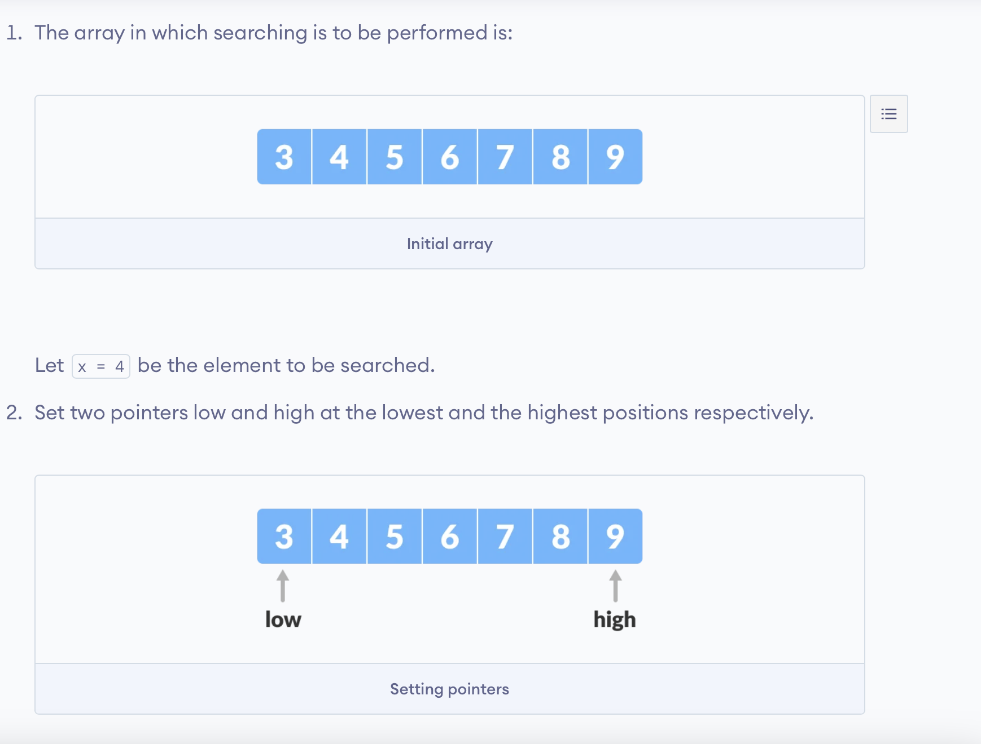
Binary Search Algorithm (cont’d)
CMPE223 ALGORITHMS AND PROGRAMMING

Slide 10
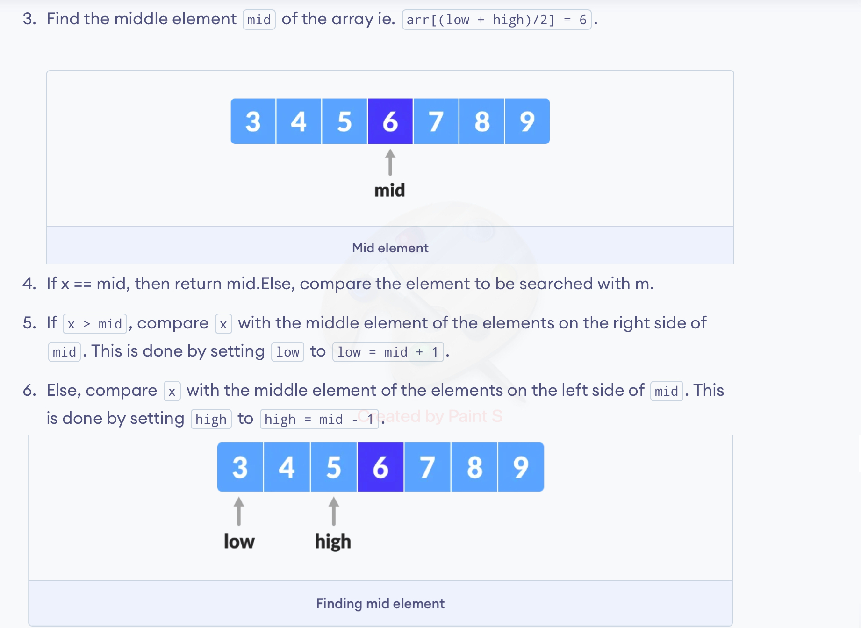
Binary Search Algorithm (cont’d)
CMPE223 ALGORITHMS AND PROGRAMMING

Slide 11
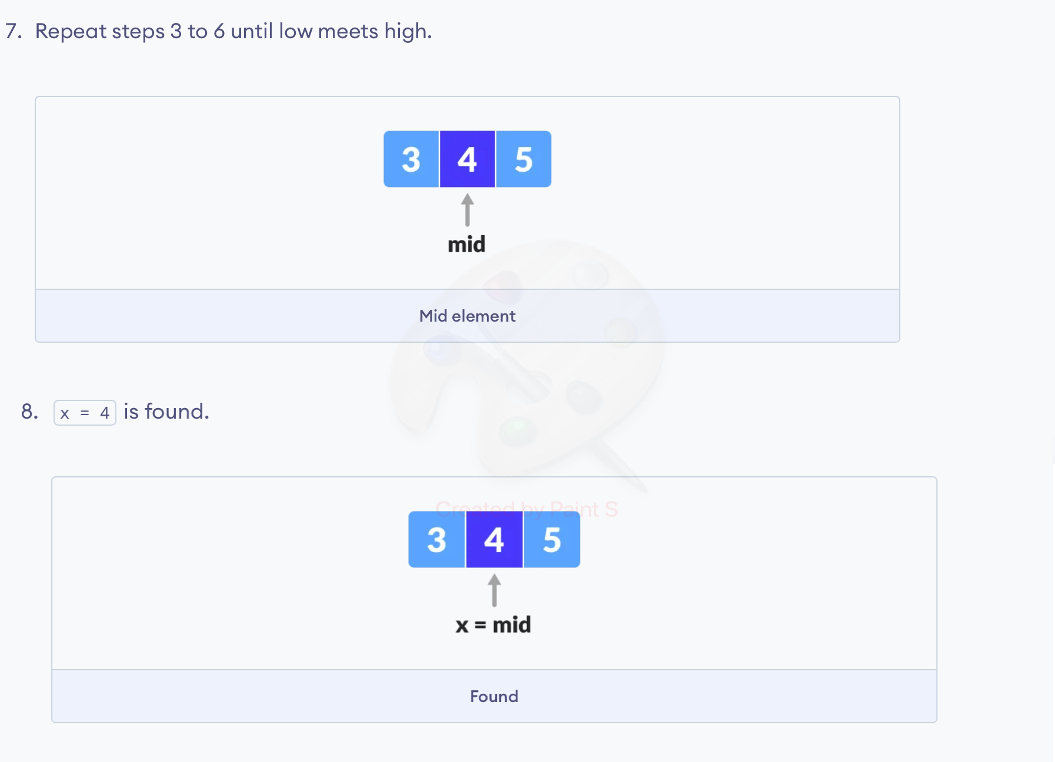
Binary Search Algorithm (cont’d)
CMPE223 ALGORITHMS AND PROGRAMMING

Slide 12
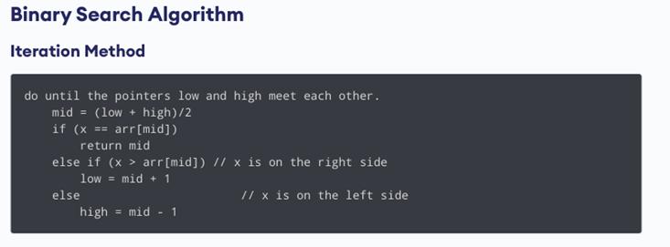
Binary Search Algorithm (cont’d)
CMPE223 ALGORITHMS AND PROGRAMMING

Slide 13
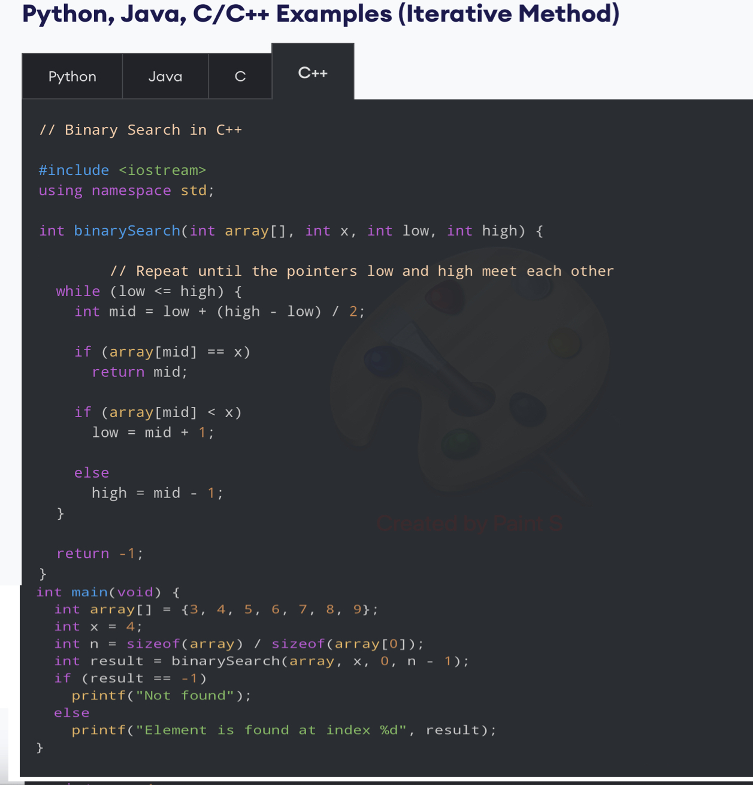
Binary Search Algorithm (cont’d)
CMPE223 ALGORITHMS AND PROGRAMMING

